Slide 1
Stop Sign Policy
CITY OF DUARTE | October 22, 2019
Optional Picture Caption

Slide 2
Presentation Overview
Review the State’s Manual on Uniform Traffic Control Devices (MUTCD) process to identify stop sign locations
T-Intersections
Minor Street Stop
Multi-Way Stops
Discuss additional criteria recommended for the City’s version of a Stop Sign Policy.
Demonstrate how the Stop Sign Policy applies to four case study intersections within the City
2

Slide 3
PURPOSE:
Clarify the process of identifying appropriate locations for the installation of a stop sign. This policy can be applied to intersections without current stop control or intersections that have only partial control (T-intersections or two-way stop control).
3

Slide 4
T-Intersections
Install yield sign at locations where motorists currently are not conforming to the statute: “the driver of any vehicle on a terminating highway shall yield the right-of-way to any vehicle on the intersecting continuing highway.”
Install stop sign on stem if sight distance is not met, based on guidelines in American Association of State Highway and Transportation Officials (AASHTO) publication “A Policy on Geometric Design of Highways and Streets.” Apply Case C methodology for three-legged intersection.
4

Slide 5
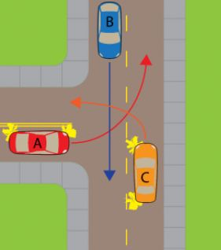
Minor Street Stop
According to MUTCD 2B.06, stop sign is warranted when:
The vehicular traffic volumes on the through street or highway exceed 6,000 vehicles per day;
A restricted view exists that requires road users to stop in order to adequately observe conflicting traffic on the through street or highway; and/or
Crash records indicate that three or more crashes that are susceptible to correction by the installation of a STOP sign have been reported within a 12-month period, or that five or more such crashes have been reported within a 2-year period. Such crashes include right-angle collisions involving road users on the minor-street approach failing to yield the right-of-way to traffic on the through street or highway.
5

Slide 6
Multi-Way Stop
According to MUTCD 2B.07:
• The vehicular volume entering the intersection from the major street approaches (total of both approaches) averages at least 300 vehicles per hour for any 8 hours of an average day, and;
• The combined vehicular, pedestrian, and bicycle volume entering the intersection from the minor street approaches (total of both approaches) averages at least 200 units per hour for the same 8 hours, with an average delay to the minor-street vehicular traffic of at least 30 seconds per vehicle during the highest hours, but;
• If the 85th-percentile approach speed of the major street traffic exceeds 40 mph, the minimum vehicular volumes warrants are 70 percent of the values provided in Items 1 and 2.
OR Five or more reported crashes in a 12-month period that are susceptible to correction by a multi-way stop installation. Such crashes include right-turn and left-turn collisions as well as right-angle collisions.
6

Slide 7
Other MUTCD Considerations
Inadequate sight distance – A multi-way stop is justified at locations where a road user, after stopping, cannot see conflicting traffic and is not able to negotiate the intersection unless conflicting cross traffic is also required to stop (MUTCD 2B.07 Paragraph 05.C)
In Vicinity of High-Pedestrian Generator – The need to control vehicle/pedestrian conflicts near locations that generate high pedestrian volumes (MUTCD 2B.07 Paragraph 05.B)
Intersection of Similar Neighborhood Streets – An intersection of two residential neighborhood collector (through) streets of similar design and operating characteristics where multi-way stop control would improve traffic operational characteristics of the intersection (MUTCD 2B.07 Paragraph 05.D)
7
Optional Picture Caption

Slide 8
Sight Distance
The proposed Stop Sign Policy recommends methods for determining whether sight distance is adequate, as follows:
For no stop control, based on the American Association of State Highway and Transportation Officials (AASHTO) “Greenbook”
For approaches that have stop control, based on the Caltrans Highway Design Manual but with stopping sight distance and assumed setbacks more appropriate for non-state highways.
Design Speed | Stopping Sight Distance (feet)
25 MPH | 150
30 MPH | 200
35 MPH | 250
40 MPH | 300
45 MPH | 360
8

Slide 9
Recommended Additional Considerations
T-intersection with Higher Volume on Stem Approach –A multi-way stop may be installed if the volume of cars entering the intersection from the currently stop or yield sign-controlled terminating street is regularly higher than the combined total of cars entering the intersection from the two-leg road.
Where the lack of stop control is unexpected– Installation of a stop sign may be justified where motorists on other approaches behave as if they expect stop sign control on the uncontrolled approach based on surrounding roadway patterns.
9
Optional Picture Caption

Slide 10
Procedures
The following is the process that will be followed in the application and approval process for public requests for stop sign control.
An engineering study will be conducted to ensure requirements within Duarte’s Stop Sign Policy or CA MUTCD are meet. The study will include the engineer’s findings along with engineering recommendations for the intersection.
Once an engineering study is completed, if engineering recommendations justify an improvement, it will be sent for review by the Duarte Traffic Safety Commission. Once the Duarte Traffic Safety Commission reviews the engineering study the City Council will be presented with the engineer’s findings and recommended actions. The Duarte City Council will finalize the process with their final motion.
10

Slide 11
Case Studies

Slide 12
Bradbury Avenue & Bloomdale Street
Recommend multi-way stop. The presence of a stop sign on the northbound and westbound approaches to the street makes drivers assume there is a stop sign while travelling southbound, even though there isn’t one. This leads drivers making northbound through movements and westbound left turns to sometimes assume they may proceed under the assumption that the southbound car will stop when it is not actually safe to do so.
Link
12
Optional Picture Caption

Slide 13
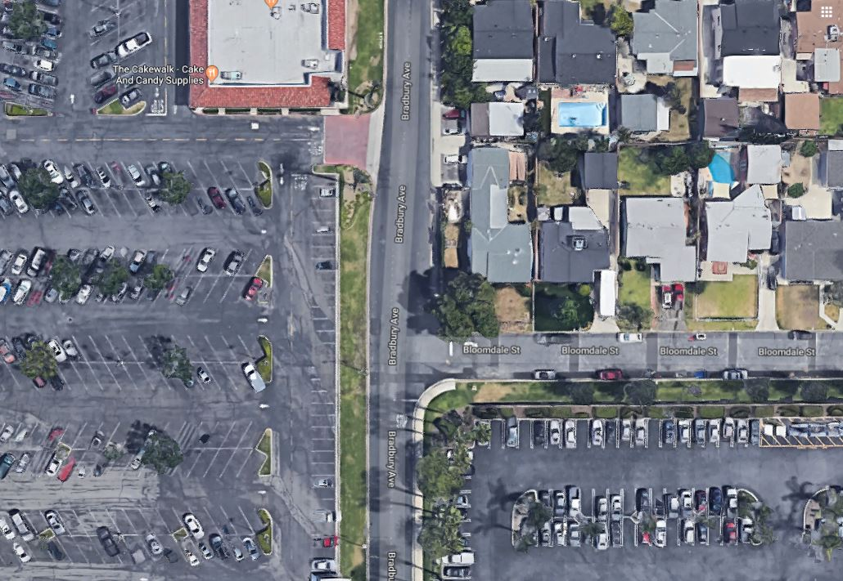
13

Slide 14
Maynard Drive & Brycedale Avenue
Installation of a minor street stop sign is warranted at the intersection of Brycedale Avenue & Maynard Drive due to sight distance for uncontrolled approaches being insufficient to meet AASHTO guidelines.
However, multi-way stop control is not justified for this intersection. Stop-controlled corner sight distance is met. Other additional considerations such as being near a high-pedestrian generator are not sufficient for a recommendation to install stop signs on all approaches to the intersection.
Link
14
Optional Picture Caption

Slide 15
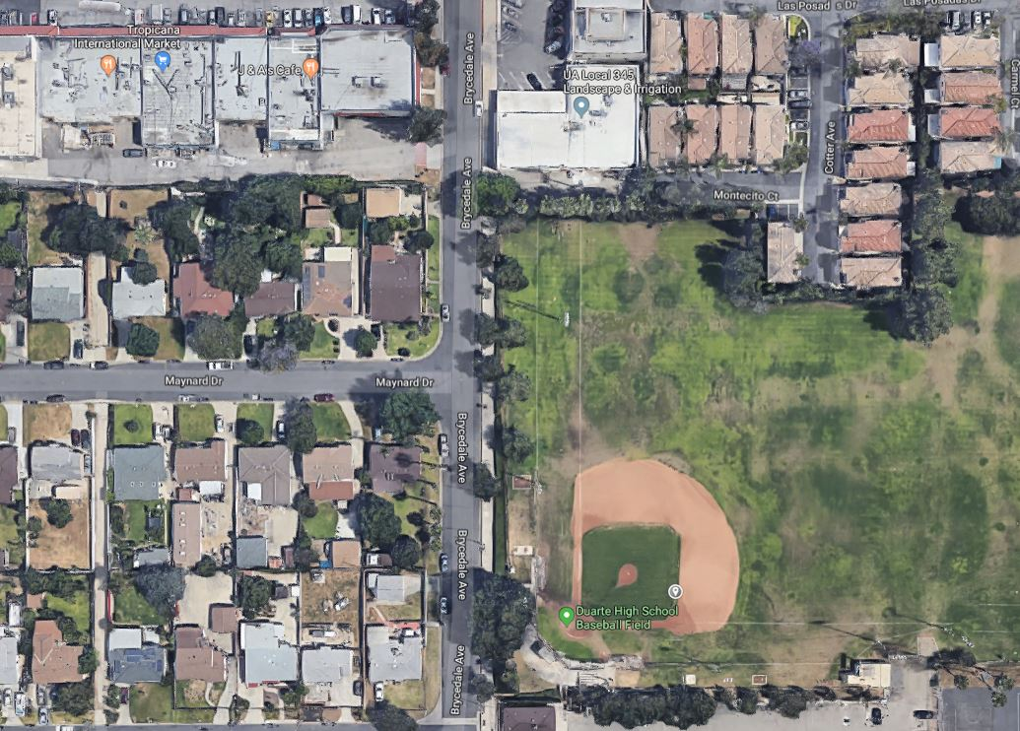
15

Slide 16
Oakhaven Drive & Random Lane
Install stop signs on minor street (Oakhaven) due to obstructions limiting the approach sight distance to below AASHTO’s guidelines.
Multi-way stop is not recommended. Vehicles approaching from both the north and from the south would be able to be seen by a motorist stopped on Oakhaven Drive. In some cases the vehicle may need to proceed close to the edge of the curb or even into the roadway to see this distance, especially looking south from the east leg of Oakhaven Drive. However, when a minor road vehicle positions itself in this way, it will not require major road drivers to divert from their normal path of travel.
Link
16
Optional Picture Caption

Slide 17
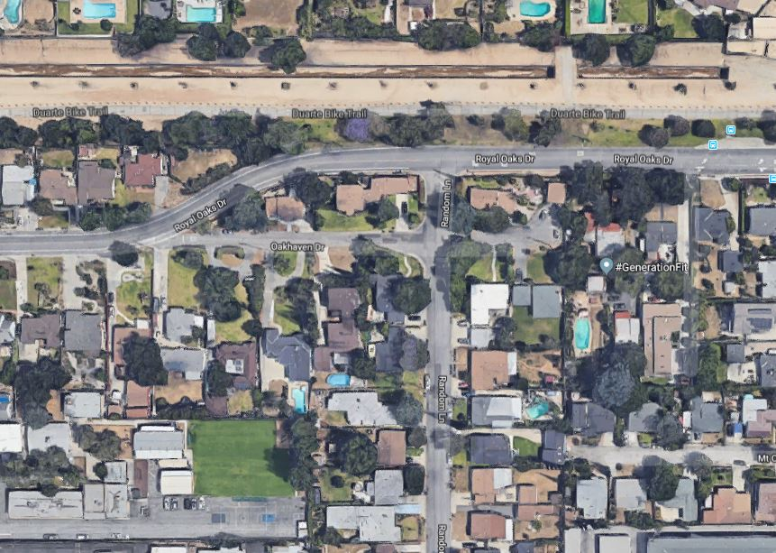
17

Slide 18
Greenbank Avenue & Deerlane Drive
Recommend multi-way stop at this T-shaped intersection as terminating street volume is heavier than the through street during peak hours. The reason for this result is the presence of Valley View Elementary School on the north side of Deerlane Drive, meaning vehicles exit school drop off using this street.
Link
18
Optional Picture Caption

Slide 19
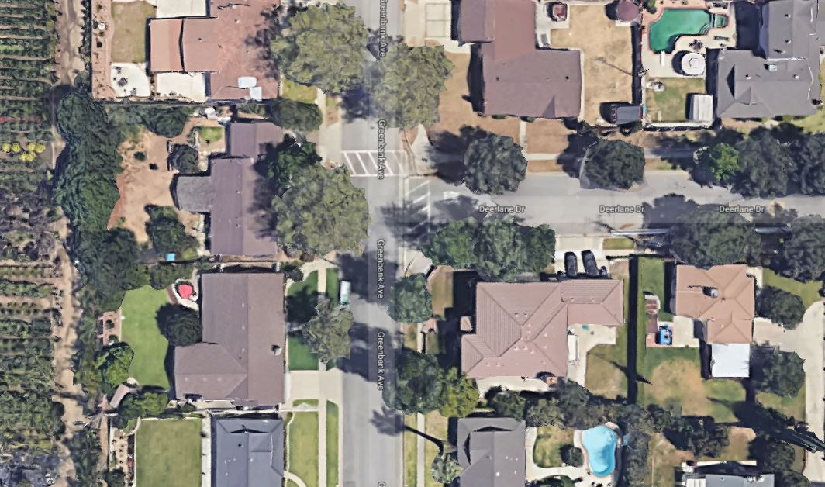
19

Slide 20
Questions?

