Slide 1
Freeway Walls and Utility Box Art Ad Hoc Committee Recommendation
Utility Box Art Program Guidelines and 2024 Call for Artists
Jason Golding
Albert Nuñez

Slide 2
Research Gathered
Cities Surveyed:
Arcadia
Azusa
Chino Hills
Costa Mesa
Dana Point
Fountain Valley
Monrovia
Napa
Rancho Cucamonga
Torrance
Vinyl wraps selected due to: longevity, inherent graffiti protection, and ease of maintenance

Slide 3
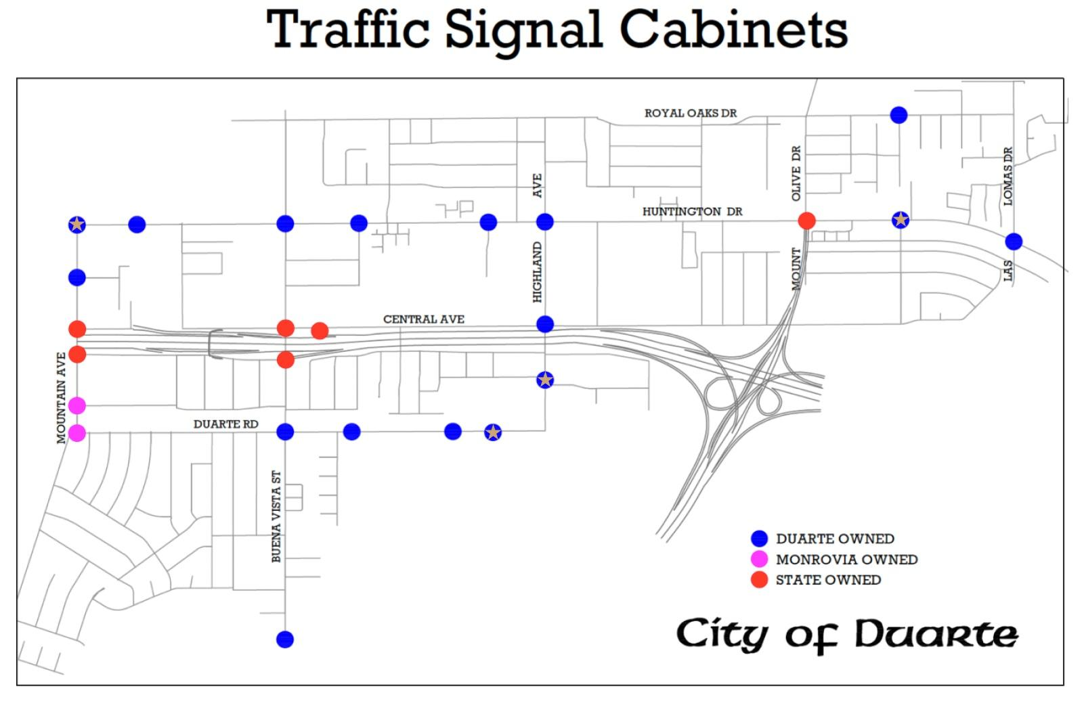

Slide 4
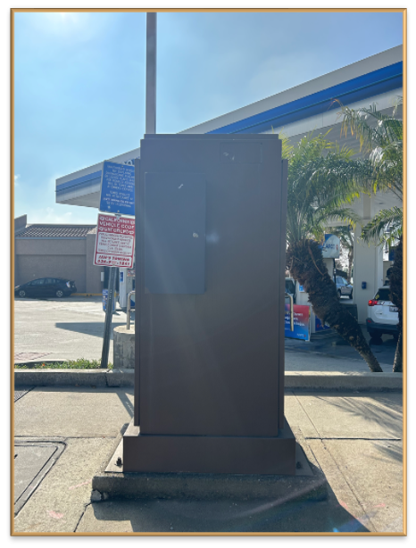
Utility Box #1
Southeast corner of Huntington Drive and Mountain Avenue
Theme chosen is “Route 66”

Slide 5
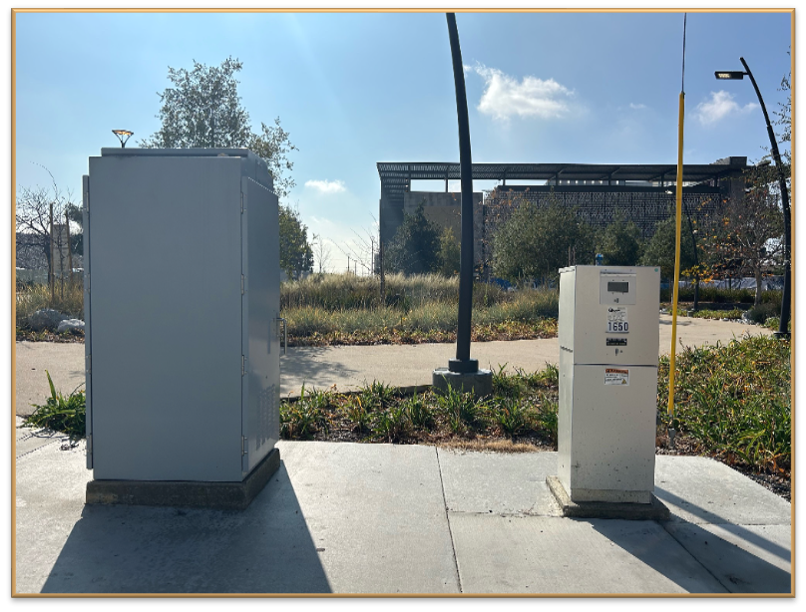
Utility Box #2
Southwest corner of Duarte Road and Circle Road
Theme chosen is “Medical Health”

Slide 6
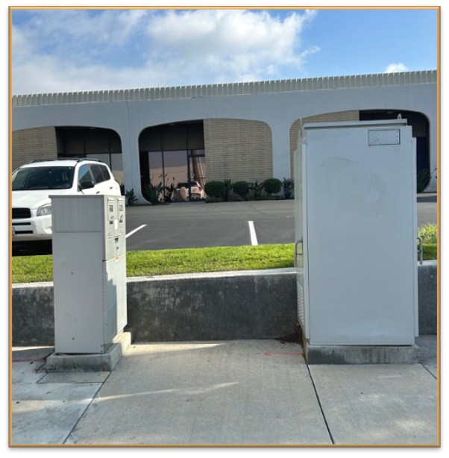
Utility Box #3
Northeast corner of Fasana Road and Highland Avenue
Theme chosen is “Transportation”

Slide 7
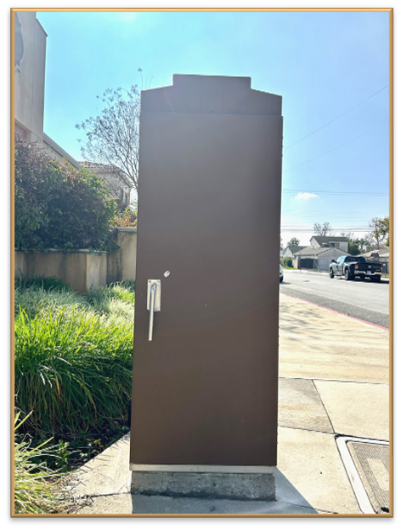
Utility Box #4
Southeast corner of Huntington Drive and Crestfield Drive
Theme chosen is “Childhood”

Slide 8
Projected Timeline
Call for Artists announced: May 6, 2024
Application submission deadline: July 8, 2024 by 6 PM (PDT) or until 100 complete applications are received
Artwork evaluated by Arts Ad Hoc Committee: August-September 2024
Artwork approved by City Council: September-October 2024
Final design completed: November, 2024
Project(s) installed: January, 2025 (dependent upon vendor availability)

Slide 9
Review Process
Artist’s Stipend:
Single utility box - $750.
Includes a meter pedestal - additional $250.
Artwork/Artist Recognition:
City webpage dedicated to the program, installed artwork, and corresponding artist.
QR codes embedded into vinyl wrap. Provides pedestrians an opportunity to learn about the artwork and artist in the public realm.
City responsibilities:
Administration of the Utility Box Art Program.
Work with artist and vendors on producing final artwork.
Prepare utility boxes for vinyl wrap installation.
Inspect and maintain installed artwork and replace vinyl up to three (3) years.

Slide 10
Budget Breakdown

Slide 11
Future Ad Hoc Committee Options
Ad Hoc Committees are limited in duration.
Utility Art Box Program has been designed to function for several years or potentially longer.
Options:
Option 1: Form a new Arts Ad Hoc Committee each year, which will require completion of the appointment process annually.
Option 2: Convert the current Ad Hoc Committee into a standing Commission.
Option 3: Have an existing Commission take on the current responsibilities of the Arts Ad Hoc Committee.

