Slide 1
Award of Contract: Royal Oaks Park Gazebo Replacement
April 23, 2024
Manuel Enriquez
Parks & Recreation

Slide 2
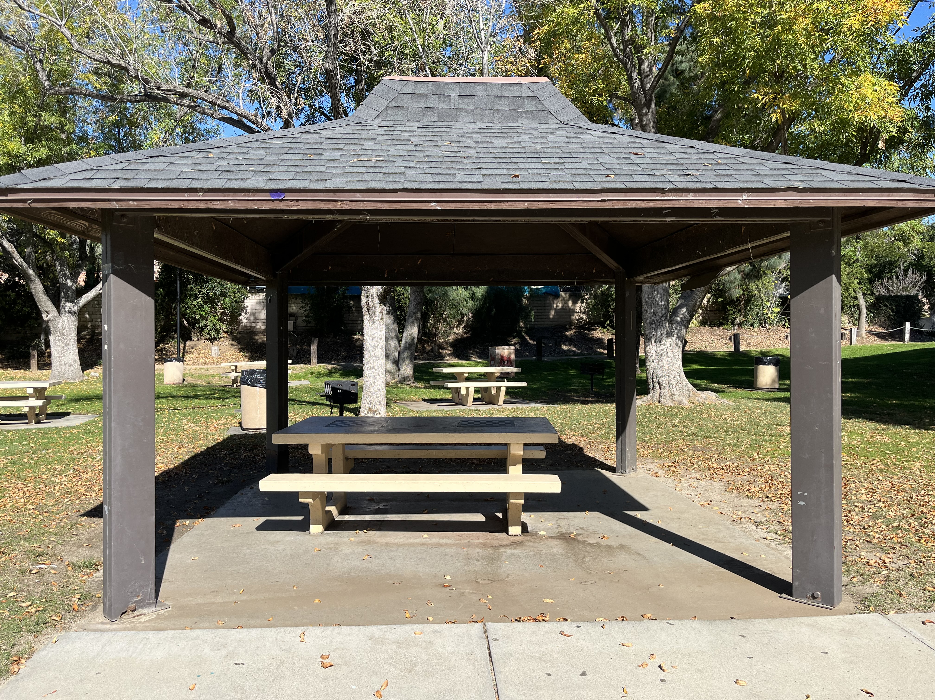
Background
Need for replacement, metal corrosion at foundation.
Included $80K in approved 2023/24 budget for the replacement of the Royal Oaks Park Gazebo

Slide 3
Background (continued)
Scope of work consist of the necessary labor, equipment, and machinery to remove and properly dispose of the existing metal shade structure and concrete pad, forming and pouring of new concrete pad, and the assembly and installation of one (1) Navajo Style Shelter with four posts, including rain gutters and downspouts.
On March 7th, the City published an invitation to bid on the Royal Oaks Park Gazebo Replacement, Project 24-9.

Slide 4
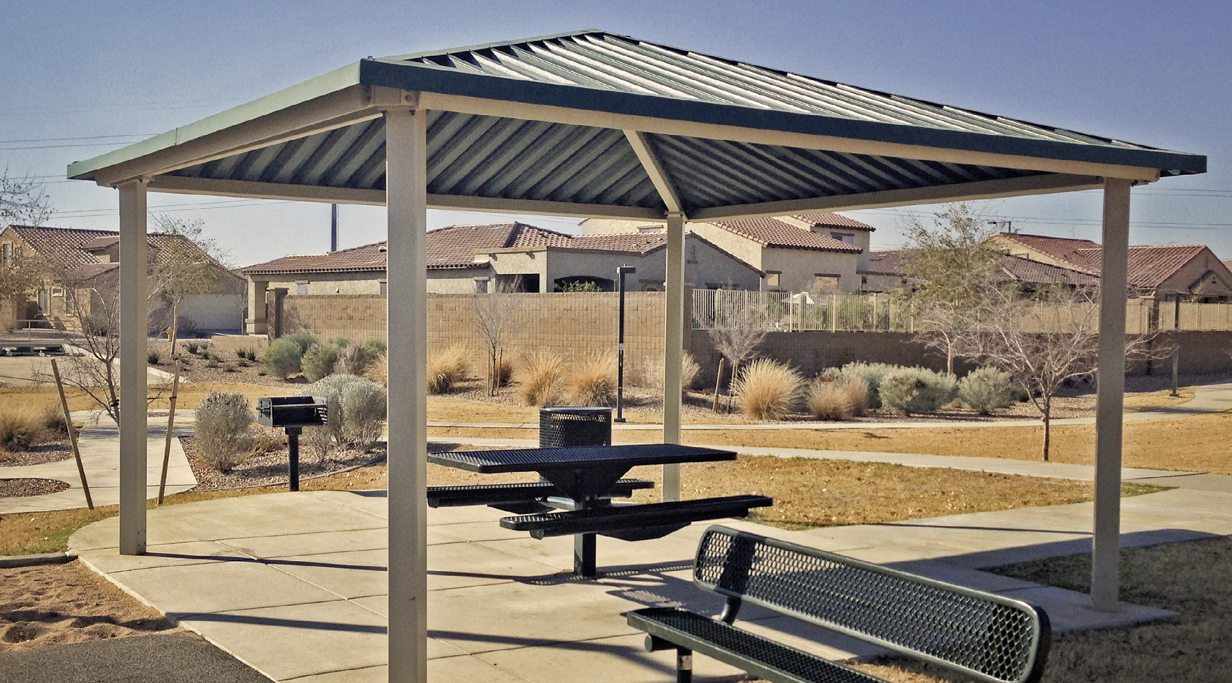
Bid Outcome
On March 27th, the City received four (4) bids for the subject project.
Lowest responsive and responsible bidder, FS Contractors, Inc. at $64,900.

Slide 5
Staff Recommendation
Staff recommends City Council award the construction contract for the Royal Oaks Park Gazebo Replacement Project to FS Contractors, Inc., as the lowest responsive and responsible bidder in the amount of $64,900, in addition to a ten percent contingency, for a total project budget not to exceed $71,390.
Funded by California Drought, Water, Parks, Climate, Coastal Protection, and Outdoor Access for All Act of 2018 Per Capita Program.

